Slide 1
BioEthics Seminar 2 Searching PubMed
Vivian McCallum, MLS
September 28, 2022

Slide 2
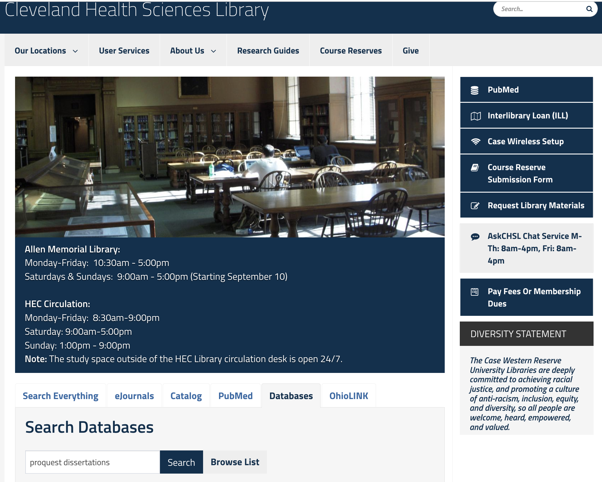
https://case.edu/chslibrary/
This quick link takes you to PubMed to access full text licensed by the library.

Slide 3
“Free” Searching for Subjects or Concepts
You can quickly search PubMed using free searching. This kind of searching relies on the database algorithms to find what it thinks you’re looking for.
This function is better now than it used to be, but while it is fast, it’s often not accurate. This is one of three ways we search PubMed.

Slide 4
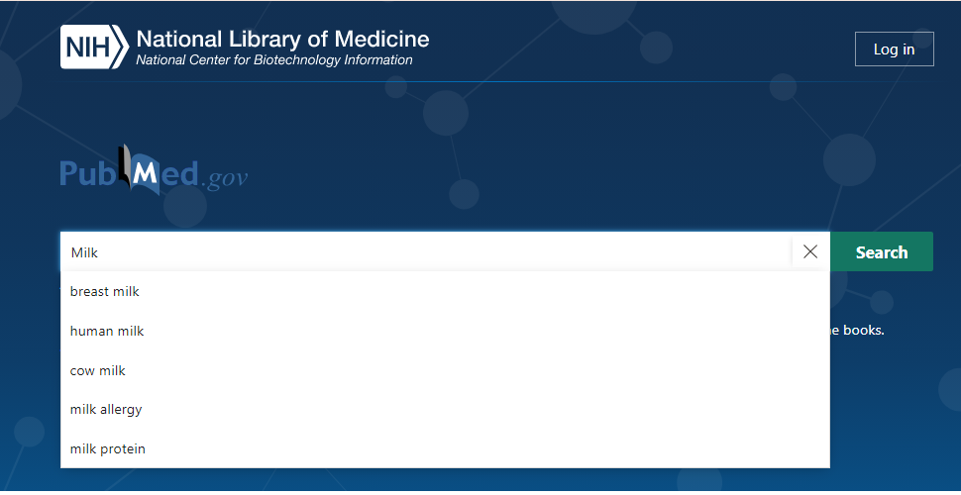
Milk
Let’s say your doing research on milk.
Enter the term milk in the search bar & click Search.

Slide 5
A Broad Search Results In HIGH RETRIEVAL.

Slide 6
Click On Advanced to See What PubMed has Searched.

Slide 8
The PubMed Advanced Search Builder Shows You how the Database Searched the Term you Entered.

Slide 9
Brainstorm: what kind(s) of milk?
Focus Your Search
Almond Milk
Oat Milk
Cashew Milk
Soy Milk
Cow’s Milk
Goat’s Milk
Sheep’s Milk
Milk Substitutes
Non-Dairy Milk
Milk Proteins
Milk Allergies
Milk Products

Slide 11
Combining in the Advanced SB

Slide 12
Click on the three dots next to the term you’d like to combine. Then click on Add query. This adds the term to the search builder (above).

Slide 13
AND
OR
Combine subjects/concepts using AND or OR in all caps

Slide 14
Connect terms for a single concept (e.g. Milk) with OR

Slide 15
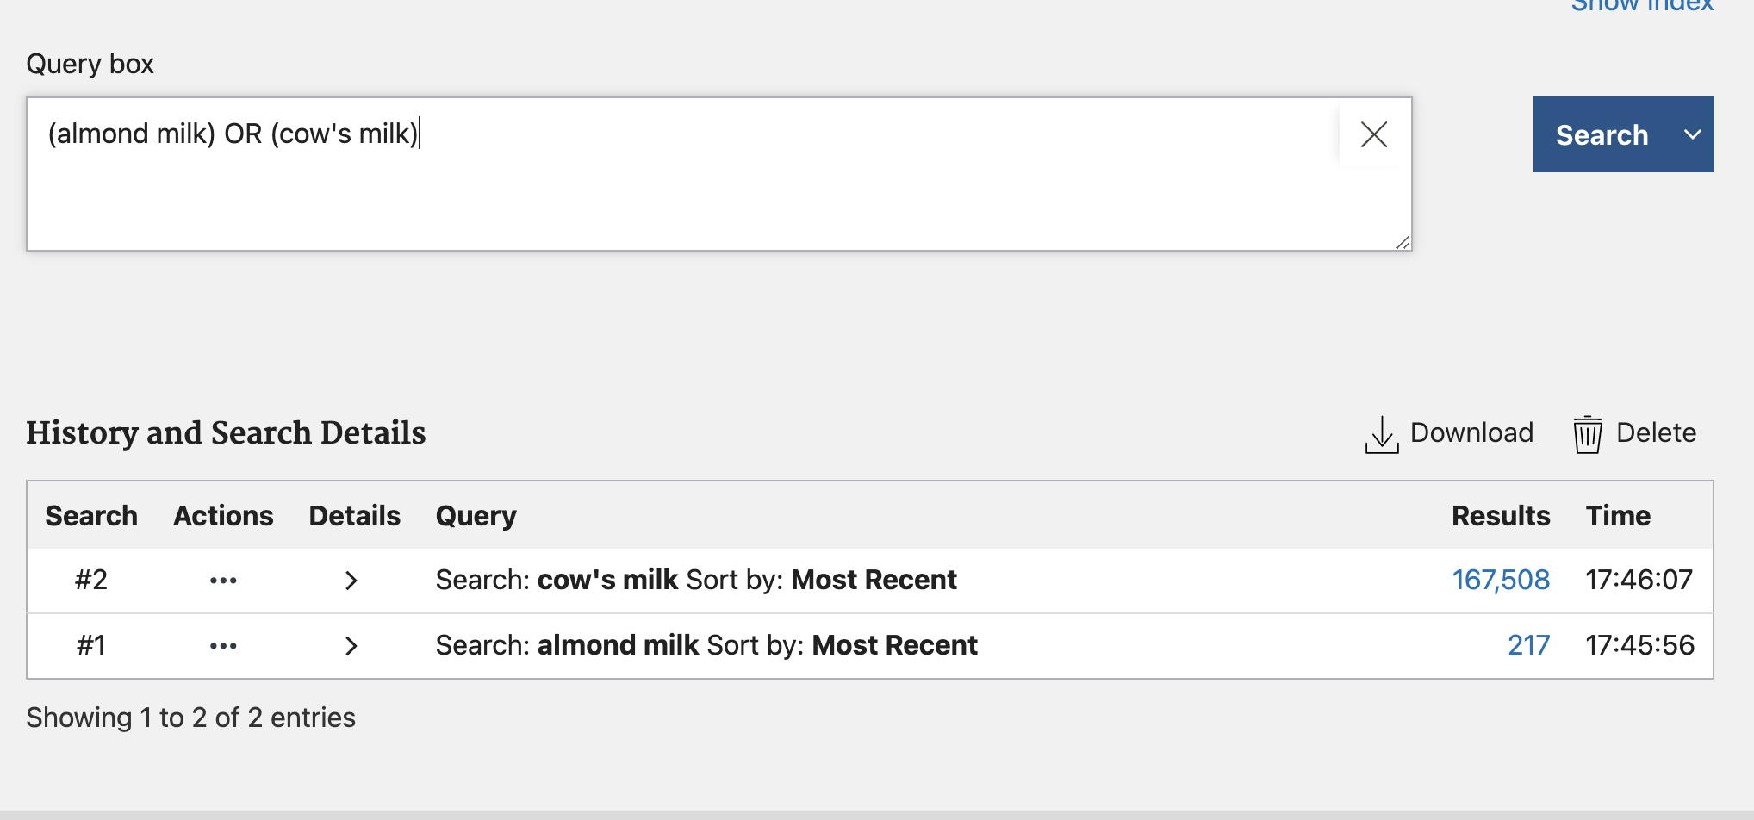
Focus the results further by adding growth hormones to the search.

Slide 16
AND
OR
Combine subjects/concepts using AND or OR in all caps

Slide 17
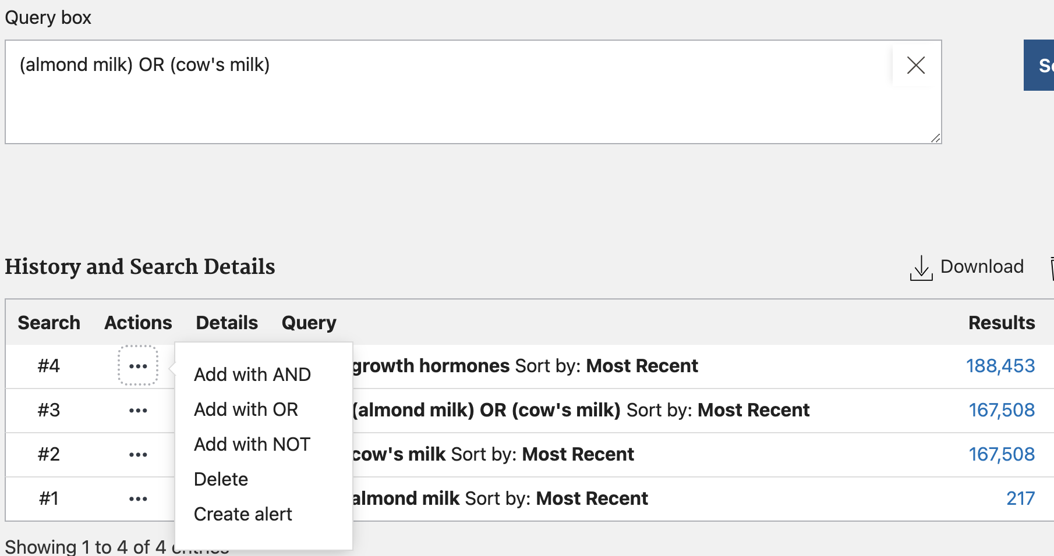
Combine multiple concepts with AND

Slide 19
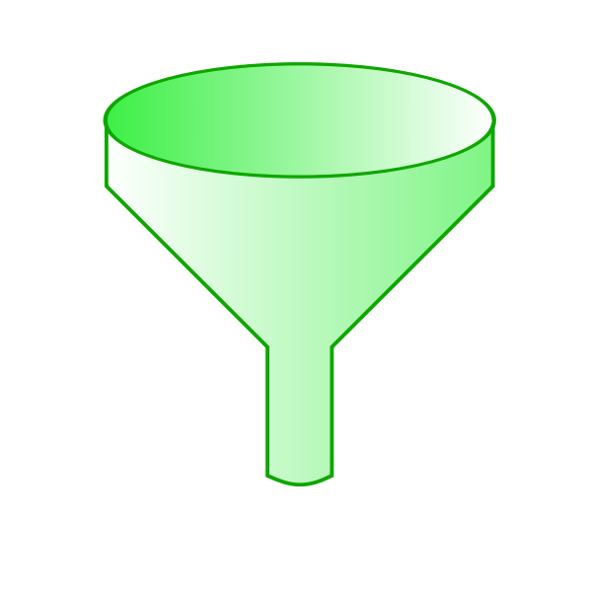
Free searching is fast & OK,
but there are two better, more specific methods of searching.
One of those ways is Keyword Searching with [tiab]
Keyword Searching
[tiab]

Slide 20
Keyword searching looks for:
Natural language, which is how we speak and write.
Titles, abstracts, and author assigned keywords.
Acronyms, new terminology, and phrases.
Finds:
New terminology, jargon, acronyms, phrases
The NEWEST articles, not yest assigned MeSH terms.

Slide 21
Things to remember when keyword searching
Know, remember, and use ‘Directives’.
Check the search results box for accuracy after you use a phrase
Remember that sometimes phrases are not found as phrases
Recognize that some acronyms have multiple meanings which skews the results of the search

Slide 22
[tiab] Using Directives to search for subjects/concepts in PubMed
Say you want literature about Brain CTs…
Clear the PubMed search box and enter:
Brain CT.

Slide 23
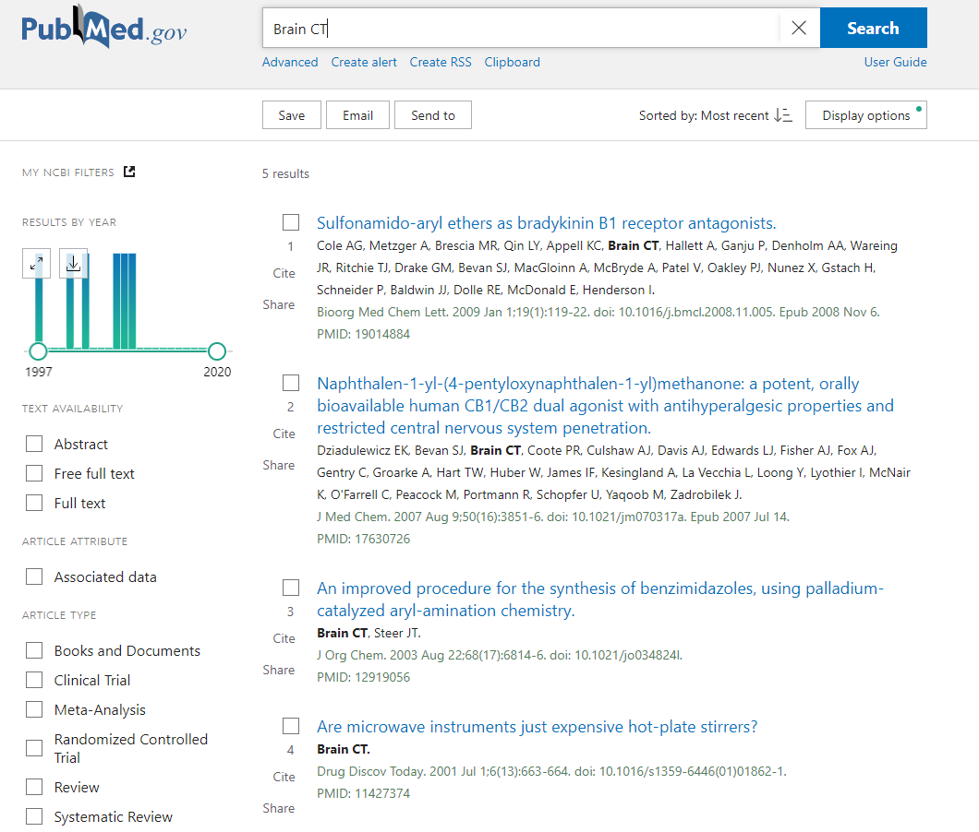

Slide 24
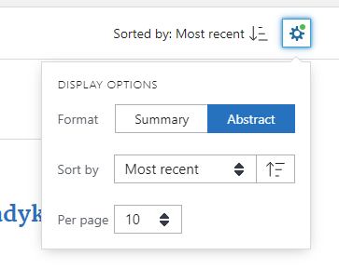
PRO TIP:
Click on the gear
Change Format to Abstract.
Change Sort By to Most Recent.
Change Per Page to 200.

Slide 25
So what happened?
PubMed has powerful algorithms and functions at work in the background.
One function is called the author format, which is a word with one or two letters after it. Any time the database recognizes this format, the function kicks in.
So, how to we find articles about brain CT’s?

Slide 26
Keyword search using [tiab]:
When you want a very specific and reproduceable keyword/phrase search (often), use the directive [tiab] after every word or phrase you’re searching.
Tiab stands for Title/Abstract
Bonus – you get author assigned keywords, too
In the search box, where it says Brain CT, add the [tiab] directive after the phrase. It should look like this:
Brain CT[tiab]

Slide 27
When doesn’t [tiab] work?
Acronyms or terms that have multiple meanings: Orientation Proprioception Sexual orientation Work/school orientations Fiber orientation POP Plaster of Paris Progestin only Pills Pelvic Organ Prolapse Phrases:
[tiab] will search for phrases, but sometimes the phrase is not found.
Check the Search Details in the Advanced Search Builder to make sure the search was searched accurately.

Slide 28
[Tiab] practice
Choose a pair of terms to search. Enter each term and run a search without, and then with [tiab]. Compare the citations from each variation:
Star Wars
Star Wars[tiab]
Harry Potter
Harry Potter[tiab]
nursing home
nursing home[tiab]
Look in the advanced search builder
Check out the kinds of results
What jumps out at you as odd?

Slide 29
A 3rd Way to Search PubMed: Medical Subject Headings [MeSH]
MeSH is a controlled language index.
MeSH stands for: Medical Subject Headings.
It is a separate database which sits on top of PubMed. We use MeSH to search PubMed more efficiently.
It has historically been curated by subject specialists' indexers with PhD’s/MD’s, it is organic (changes as language changes), and carefully designed.

Slide 30
MeSH Database
Pros:
It’s very powerful and precise.
It’s reproducible.
Cons:
It takes 3+ months to index new publications with MeSH terms.
It’s not super intuitive for the user.

Slide 31
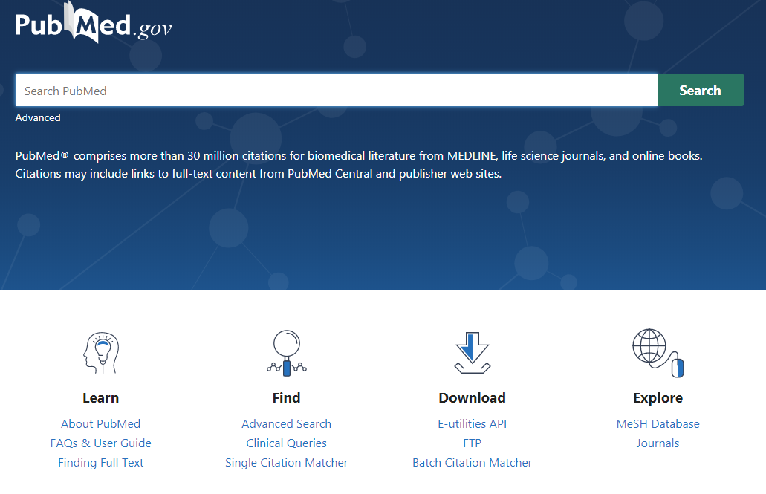
Navigating Between PubMed & the MeSH Database
From the PubMed homepage, click the MeSH Database link below the Explore icon.
HINT: if you’re on a different page in PubMed, click the PubMed logo to go to the homepage. Then click on the MeSH Database

Slide 32
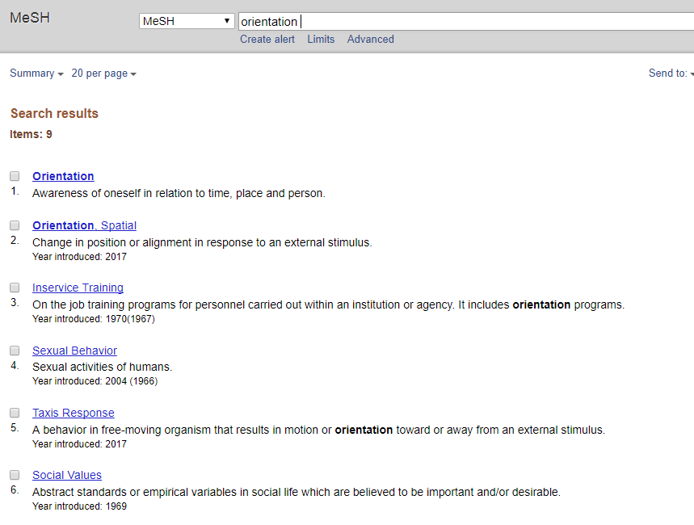
MeSH Heading Examples

Slide 33
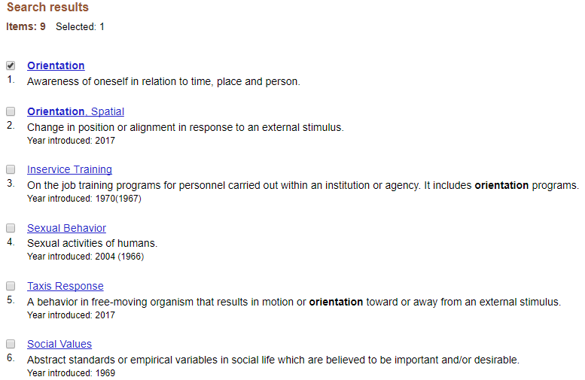
Each option is a hyperlink that takes you to the MeSH record. These contain lots of information
You can also click on the box to the left to choose the term you want.

Slide 34
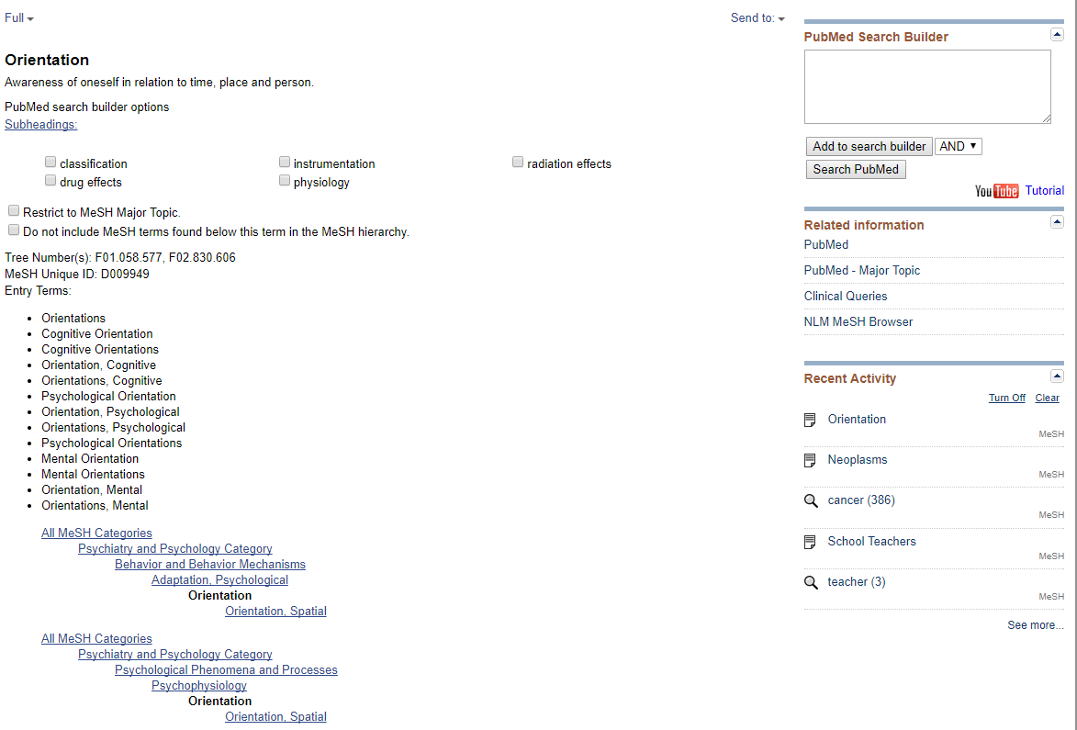
Subheadings narrow a search
Entry Terms= synonyms
Hierarchical Tree

Slide 35
PubMed Search Builder is where we tell the database what to do

Slide 36
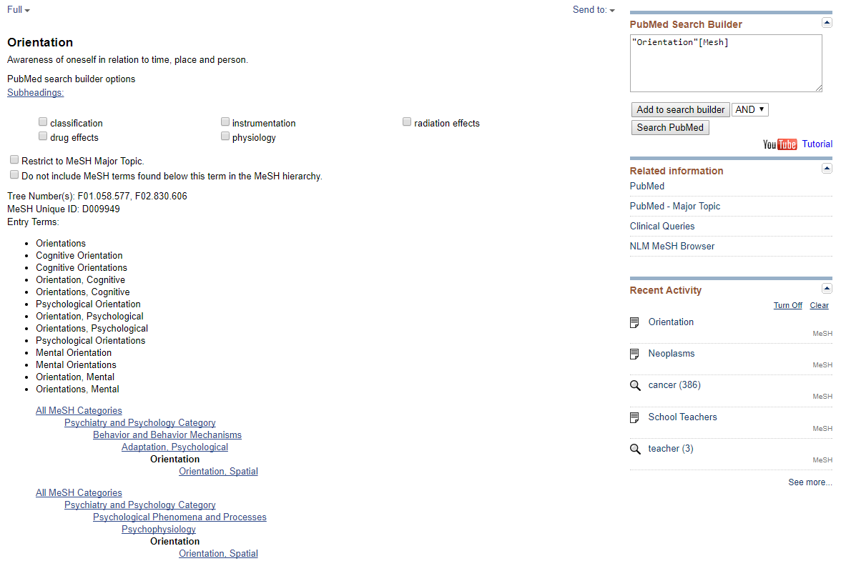
Click on “Add to Search Builder” to put the MeSH term into the box. Then click “Search PubMed”

Slide 37
Mesh PRACTICE
Find MeSH Terms For:
Healthcare disparities in the LGBTQ population

Slide 38
Search MeSH For LGBTQ
The corresponding MeSH term is
Sexual and Gender Minorities.

Slide 39
Search LGBTQ as a Textword with [tiab]

Slide 40
Combine Terms

Slide 41
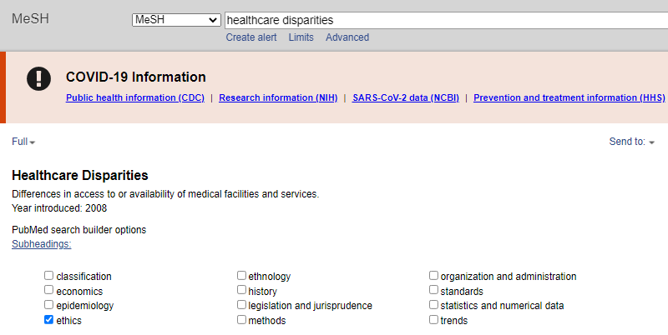
Search MeSH for Healthcare Disparities
The corresponding MeSH term is Healthcare Disparities
Note the subheading for Ethics

Slide 42
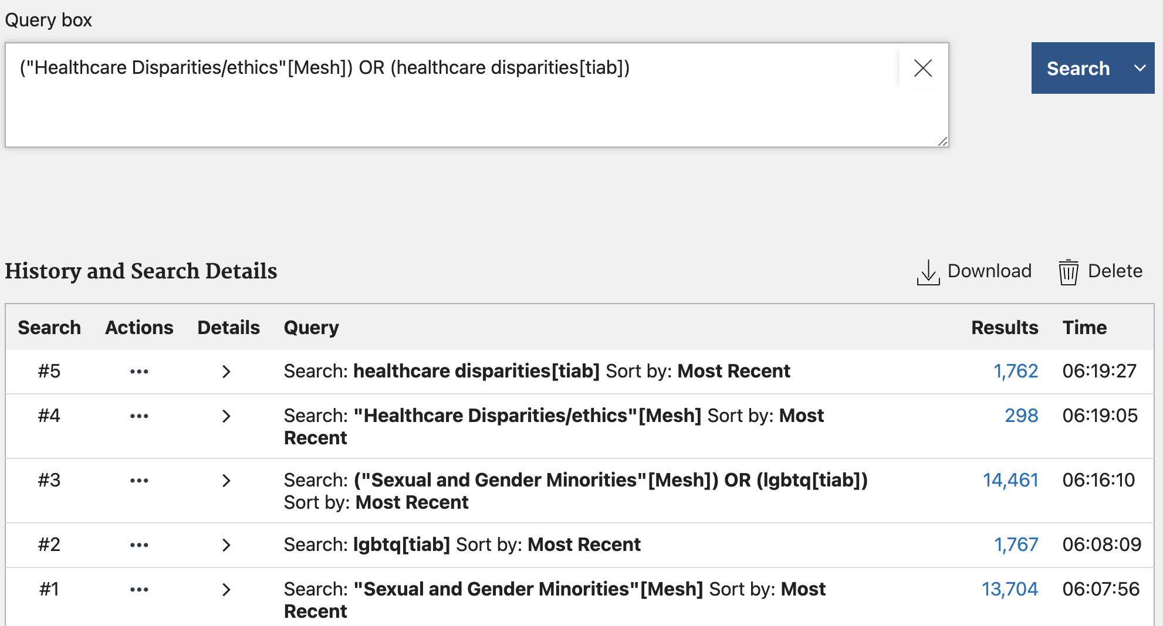

Slide 43
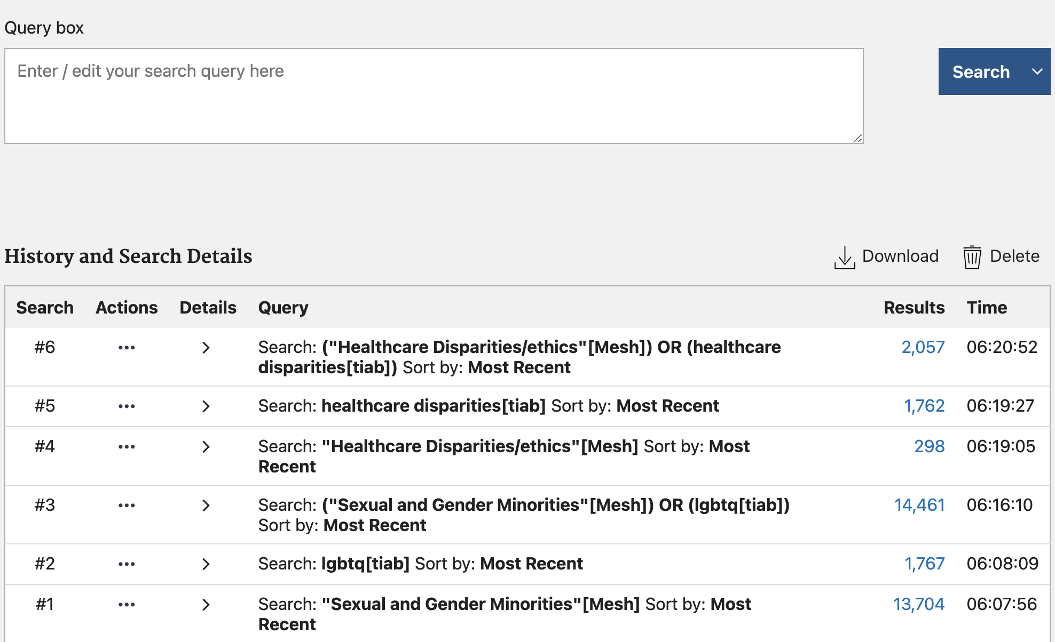

Slide 44
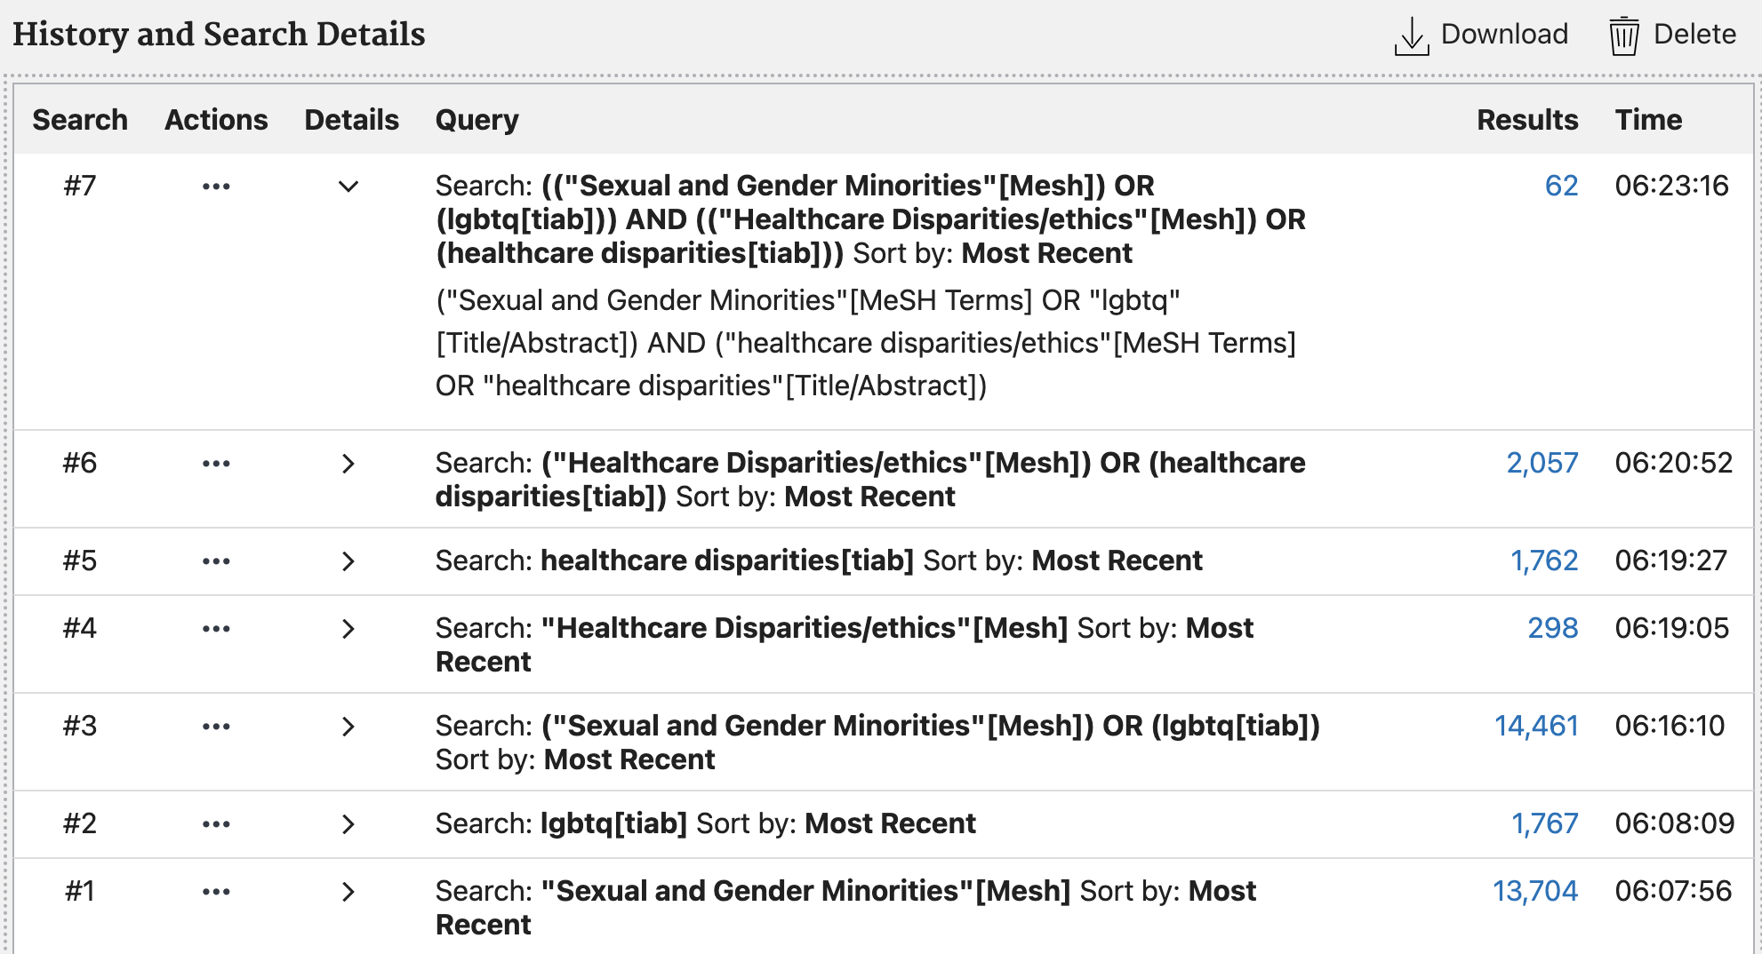
Final Search String

Slide 45
Things to remember:
All three methods of searching have pros and cons and reasons you’d want to use them for.
The more carefully you craft your question, the more accurate your results.
Each database is unique and has different tricks/tips as well as journals they index.
There are many fine points to learn about searching – and we’re happy to teach those to you.
(((("Healthcare Disparities"[Mesh]) OR (healthcare inequality[tiab])) OR (healthcare inequity[tiab])) OR (healthcare disparity[tiab])) AND (((((("sexual and gender minorities"[MeSH Terms]) OR (queer[tiab])) OR (transgender[tiab])) OR (gay[tiab])) OR (lesbian[tiab])) OR (lgbtq[tiab]))

Slide 46
QUESTIONS?

Slide 47
Thank you! Don’t hesitate to reach out after class!
Vivian McCallum
Vivian.mccallum@case.edu
Cleveland Health Sciences Library
368-3218
chslreference@case.edu

