Slide 1
Bioethics How To Do A Literature Review Seminar 1
Sept. 21, 2022Vivian McCallum, MLS

Slide 2
Seminar 1 Learning Objectives:
Navigating the library's website
Steps of a literature review
Creating a clinical question

Slide 3
CHSL Locations

Slide 4
ELECTRONIC ACCESS to Library Resources:
Start from the CHSL’s website: https://case.edu/chslibrary/
Navigate through the website to the resource you need using the quick links (right) or the Search Everything box.
Authenticate when prompted using Single Sign On / Duo.
99% of resources will be available*.
*see access guide

Slide 5
Access Guide

Slide 6
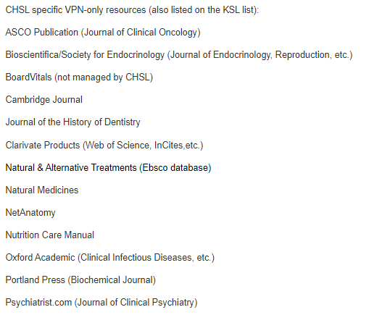
Access Guide

Slide 7
Look here for deeper information about the library and how to use our resources.

Slide 11
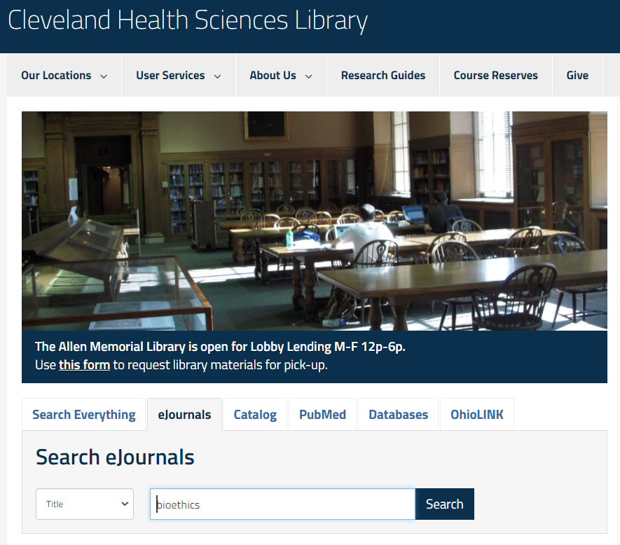
Enter the journal title into the search box

Slide 12
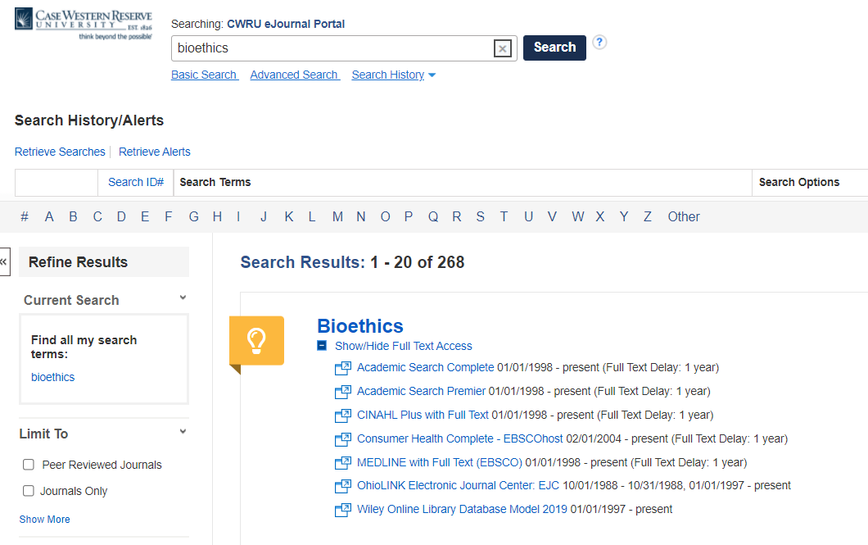
Choose the appropriate range of access.

Slide 13
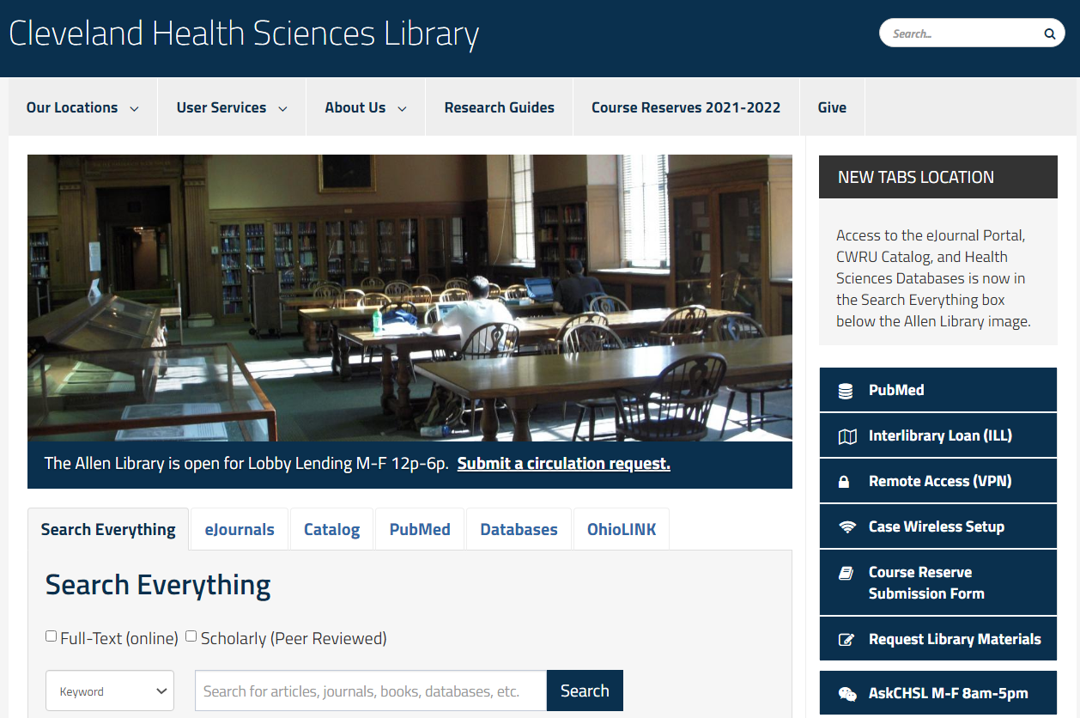
CHSL does not have electronic access to everything. Please check the eJournal Portal for availability, then create an Interlibrary Loan account and request full text articles here.

Slide 14
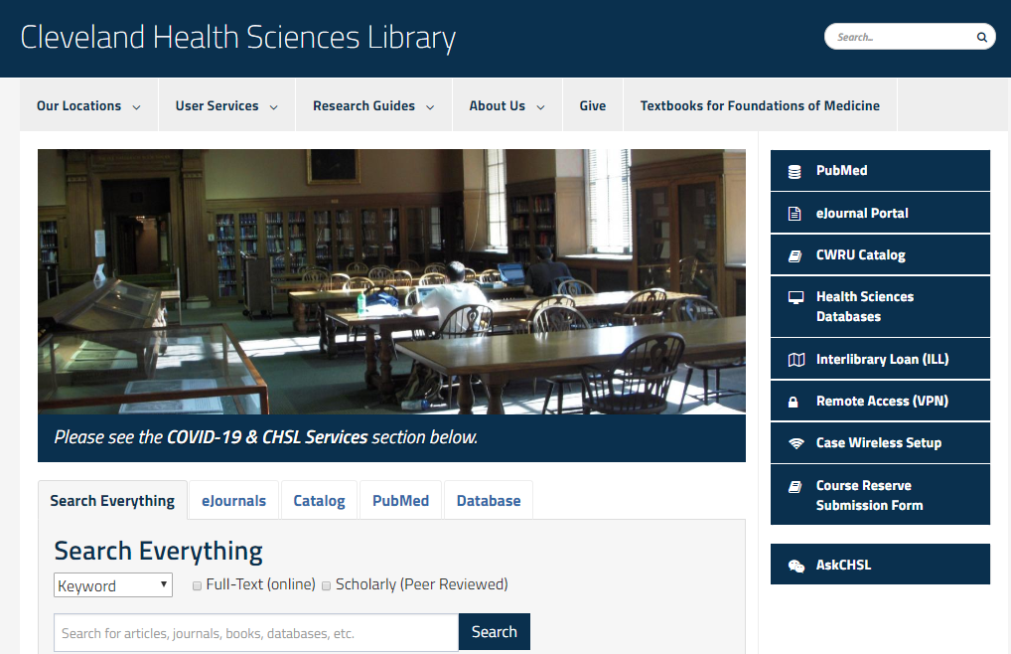
Health Sciences Databases

Slide 15
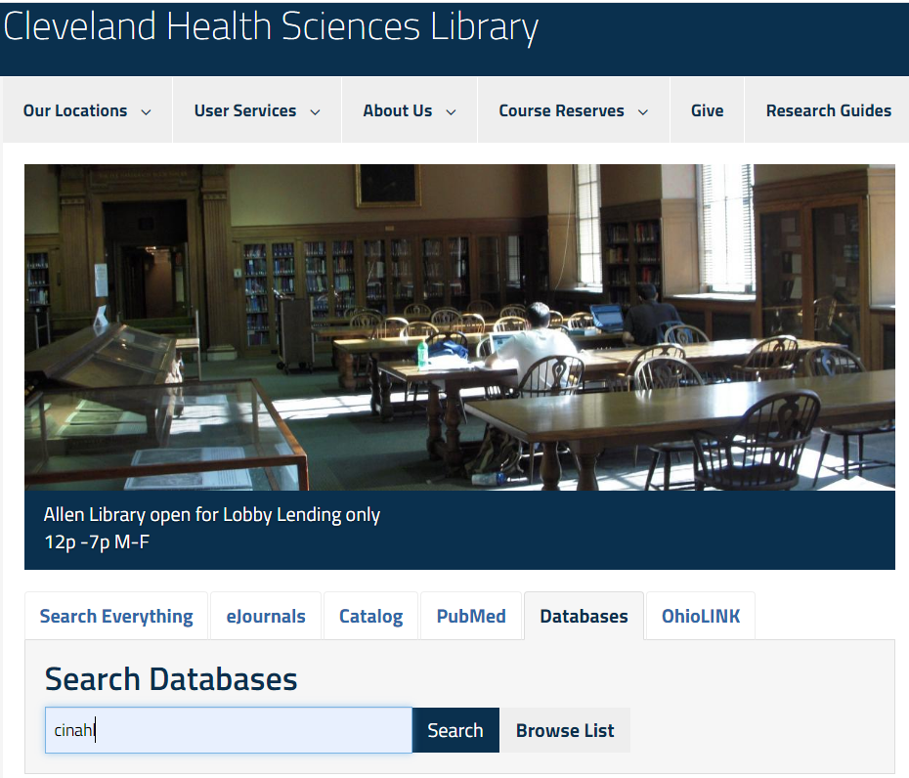
Use the search box if you know name of the database or click Browse List for the comprehensive list of health sciences databases.

Slide 16
Use this link to PubMed to access full text licensed by the library.

Slide 17
Steps to a literature review
Formulate your question
Identify relevant terminology
Search the database
Reassessment and adjustment of search, if needed
Harvesting citations and citation management
Finding full text
Reading and synthesizing the information

Slide 18
Burns PB, Chung KC. Developing good clinical questions and finding the best evidence to answer those questions. Plast Reconstr Surg. 2010;126(2):613-618. doi:10.1097/PRS.0b013e3181de24a7
The key to evidence-based decisions is a well-built clinical question.
As you start to develop your research question, you will want to look at different factors:
What type of question are you looking to answer?
What is the relevance?
Is the question answerable/are there research gaps in the literature?
Are you going to evaluate outcomes, interventions, comparisons, etc?

Slide 19
Types of Clinical Questions
Background questions ask for general knowledge about an illness, disease, condition, process or thing. These types of questions typically ask who, what, where, when, how & why about things like a disorder, test, or treatment, etc.
For example
How much overweight is considered slightly obese for an adult?
What are the clinical manifestations of thyroid disease?
What causes migraines?
Foreground questions ask for specific knowledge to inform clinical decisions. These questions typically concern a specific patient or particular population. Foreground questions tend to be more specific and complex compared to background questions. Quite often, foreground questions investigate comparisons, such as two drugs, two treatments, two diagnostic tests, etc. Foreground questions may be further categorized into one of 4 major types: treatment/therapy, diagnosis, prognosis, or etiology/harm.
For example
Is Crixivan effective when compared with placebo in slowing the rate of functional impairment in a 45 year old male patient with Lou Gehrig's Disease?
In pediatric patients with Allergic Rhinitis, are Intranasal steroids more effective than antihistamines in the management of Allergic Rhinitis symptoms?

Slide 20
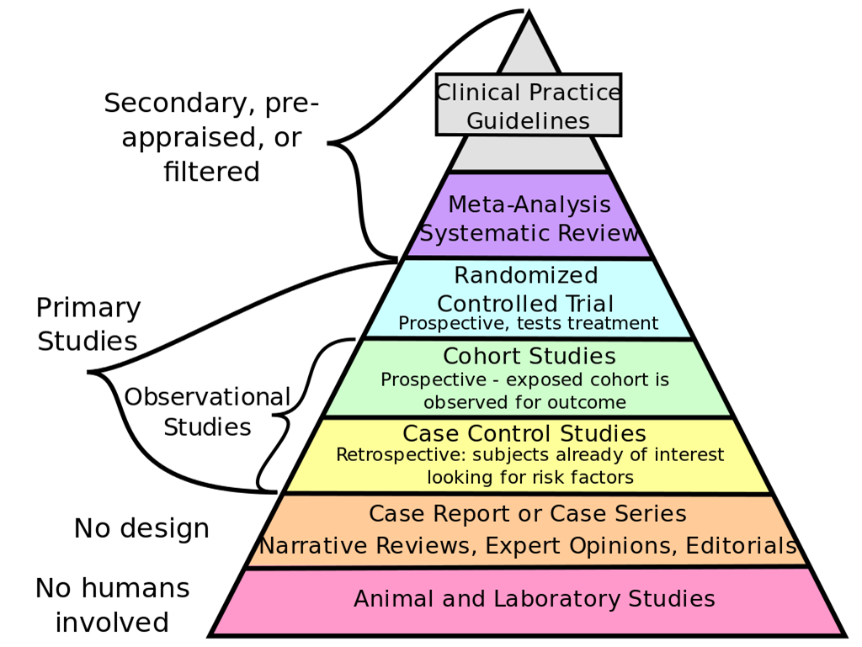
Burns PB, Rohrich RJ, Chung KC. The levels of evidence and their role in evidence-based medicine. Plast Reconstr Surg. 2011;128(1):305-310. doi:10.1097/PRS.0b013e318219c171
The evidence pyramid is a visual representation of grades of evidence. For example, a systematic review of randomized controlled trials that show consistent results provides the highest quality evidence (i.e., the “gold standard”) and is at the top of the pyramid. Towards the base we find literature such as case reports or case series which are less likely to reliably predict outcomes.

Slide 21
PICO
PICO is often used to capture the components of your question and to find relevant terminology.
P – Patient, Problem, or Population
I – Intervention, Prognostic Factor, or Exposure
C - Comparison or Intervention (if appropriate)
O – Outcome or Measure

Slide 22
PICO
P - patient, population, or problem. What is the disease or condition you need to research? What characteristics of the patient or population are important? Do you need to consider age, gender, or any other characteristics? Does the patient have any other conditions or medications that they take?
I - intervention. What is the plan for the patient? Usually this will be a form of treatment, but it may also involve monitoring the patient to check diagnosis. It may also need consideration of the frequency or strength of treatment.
C - comparison. Is there a comparative action to the intervention? Sometimes there will be an alternative treatment, sometimes you will have no administered comparison and would use non-treatment as an alternative.
O - outcome. What are the intended and potential outcomes? There may be successful treatment, but there may also be potential side effects or problems to consider. You may also need to look at cost effectiveness, or other organizational outcomes. Outcomes should also be measurable where possible, in terms of speed and scale of improvements, or the number/severity of side effects, in order to assess whether the intervention was an improvement on the comparison.

Slide 23
Other concepts:
Time
Exposure
Place/location
Behavior
Professionals
Etc.

Slide 24
You may need to brainstorm synonyms to find what you are looking for. What are the natural ways we refer to a term? What are the synonyms? What is the medical terminology? What is the jargon? Are there acronyms? What would a patient say? Was there a previous way we used to say it?

Slide 25
Breaking down the question
Breaking a clinical question down into concepts is vital for term-finding and database searching.
Each of these buckets represents a concept.
Concept 2
Concept 1
Concept 3

Slide 26
Each concept’s synonyms are OR’d together
"Computer Simulation"[Mesh] OR
"Computer User Training"[Mesh] OR
"Printing, Three-Dimensional"[Mesh] OR
"Models, Anatomic"[Mesh] OR
3 dimensional printing[tiab] OR
3d print*[tiab]
3 D Printing

Slide 27
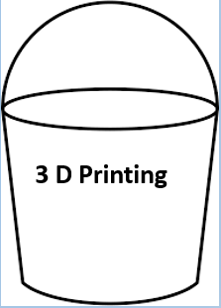
Combining Concepts
Good literature searches use controlled language and keyword searching to make ensure currency and specificity.
Think of concepts as buckets of terms: within each bucket:
We OR like terms together.
Then we AND concept buckets together.
AND
AND
Cardiac Surgery
Mitral Valves

Slide 28
Brainstorm terms by asking: What are the natural ways we refer to a term? What are the synonyms? Are there controlled language (MeSH) terms? How else is this concept captured in terminology?

Slide 30
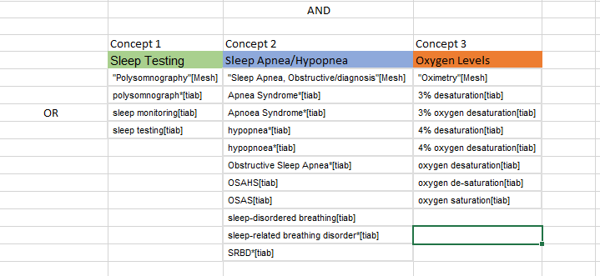
Excel is a good tool to keep concepts and terms organized.
Name your concepts at the top, then list like terms in each column.

Slide 31
QUESTIONS?

Slide 32
Thank you! Don’t hesitate to reach out after class!
Cleveland Health Sciences Library
216-368-3218
chslreference@case.edu
Vivian.mccallum@case.edu

