Slide 1
Student Org Presentation
AKA please sir, may I have money

Slide 2
My Contact Info
mel163@case.edu
(513)702-6089

Slide 3
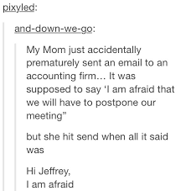
I have a vendetta against email
If you do not hear back from me within a week, send me a text or a follow up email
In case of emergency, call me! Phone calls are much better than ten emails
Please, reach out to me with any questions, comments, or concerns with GSC org related stuff. I am here to help

Slide 4
Overview
New organization approval
Each organization is eligible for $500/semester
Ability to apply for more through a GSC Co-Sponsorship (will explain this later)
Ability to apply for up to $1000 by a Interschool Co-Sponsorship (will explain this later)
Money can be used for essentially anything EXCEPT;
Paper products (napkins, plates, cups, etc)
PPE Gear
Streamers
Because all of this can be acquired from the Sparta Center for FREE!
Link to request items: http://cglink.me/s32341

Slide 5
Deadlines
Funding is now available!
Initial requests for funding must be submitted BEFORE an event!
Repeat after me: there is no funding provided for events that already took place
Once an event takes place, you have 2 weeks to submit receipts
Repeat after me: if you do not submit receipts within 2 weeks, you don’t get reimbursed
Once reimbursements are confirmed, the accounts payable office will mail a check to your SIS address.
Reimbursement check should be received within 14 business days (excludes weekends and holidays), if not please contact Matt (mjp217) or Jenn (jmb113) or Jess (jhc116)
Requests for Co-sponsorship must be submitted 1 month prior to event

Slide 6
Gift Cards
YOU CANNOT BUY THE GIFT CARDS ON YOUR OWN!
Dear god, please pay attention to this
If you are planning to get gift cards for an event you must do two things: submit a request and email me (mel163)
Submit a request like usual, just make sure you say that you need a gift card
You must purchase all gift cards through Jenn
There are a limited number of places you can get gift cards to

Slide 7
Gift Cards List
Amazon $5 - $50 (increments of $5)
BW3 $10, $15, $25
Chipotle $10, $15, $25
Dominos $10, $15, $25
Doordash $15, $25, $59
Grubhub $10, $15, $25, $35, $50, $100
Starbucks $5 - $50 (increments of $5)
Target $5 - $50 (increments of $5)
Ubereats $15, $25, $50
Uber $15, $25, $50, $100
Walmart $5, $10, $15, $20, $25, $30, $50

Slide 8
Getting GSC Recognition
Notes:
If you have already requested money this year, I have either commented on it or approved it. If you haven’t heard anything from me, then you requested it through the 2020-2021 rolling funds. Stop living in the past. Submit it through the 2021-2022 rolling funds only

Slide 9
How to get a new Org GSC’s stamp of approval
Start an organization (or get an existing GSC approved)!
Get a group of people together
Pick a theme
Pick leaders
Write a Constitution and make Bylaws
They can be on the same document
If you need sample constitutions, email me (mel163)
Email me (mel163) with your Constitution, Bylaws, and List of Committee Members
If I approve, I will email Jenn and CC you and she will set up a Campus Groups for you so you can request funds.

Slide 10
Requesting Money
Notes:
If you have already requested money this year, I have either commented on it or approved it. If you haven’t heard anything from me, then you requested it through the 2020-2021 rolling funds. Stop living in the past. Submit it through the 2021-2022 rolling funds only

Slide 11
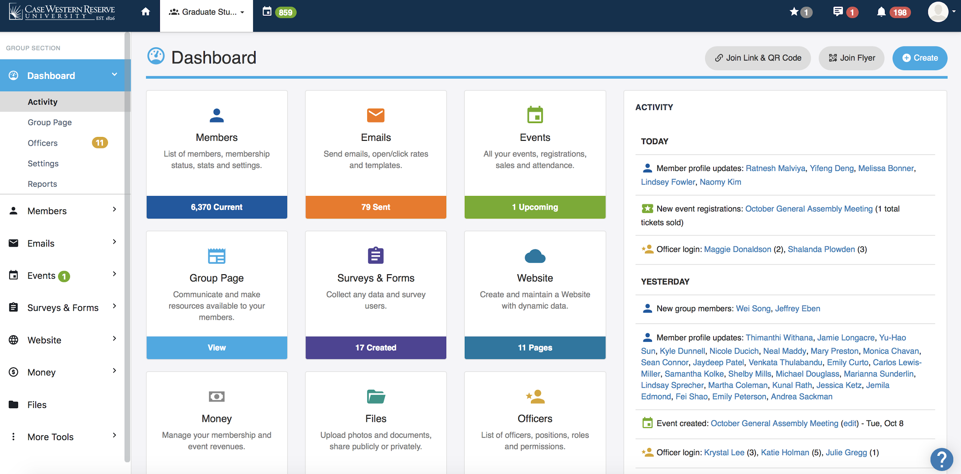
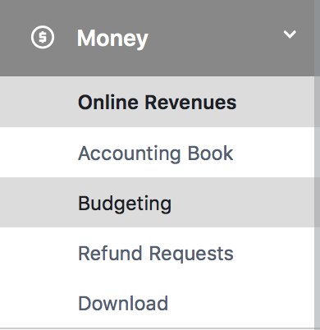

Slide 12
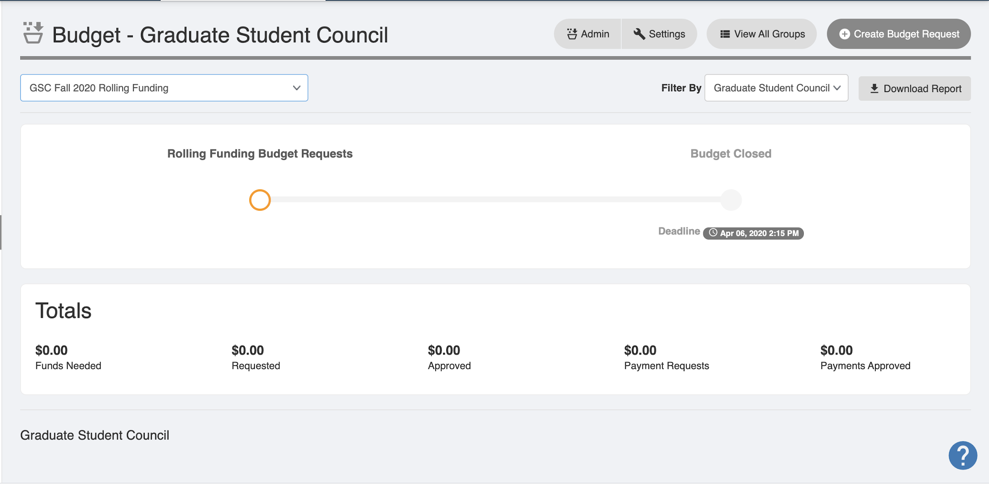

Slide 13
Choose “GSC Fall 2021-2022 Rolling Fund”

Slide 14
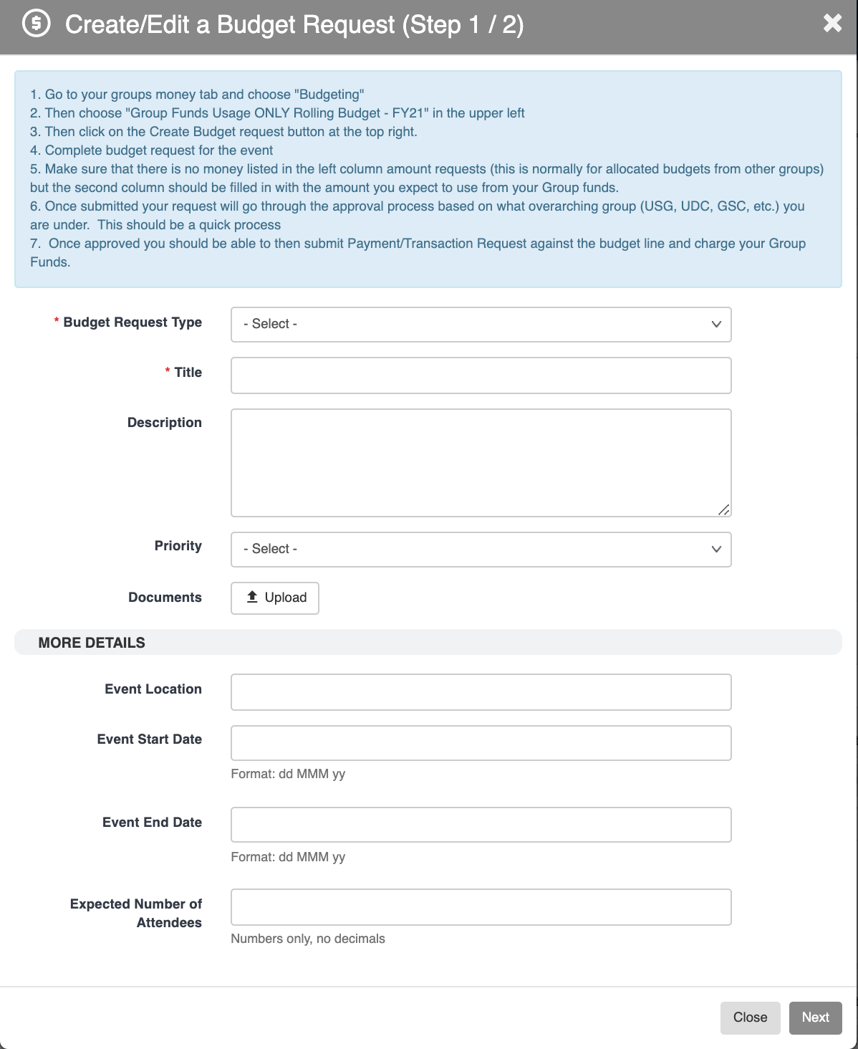

Slide 15
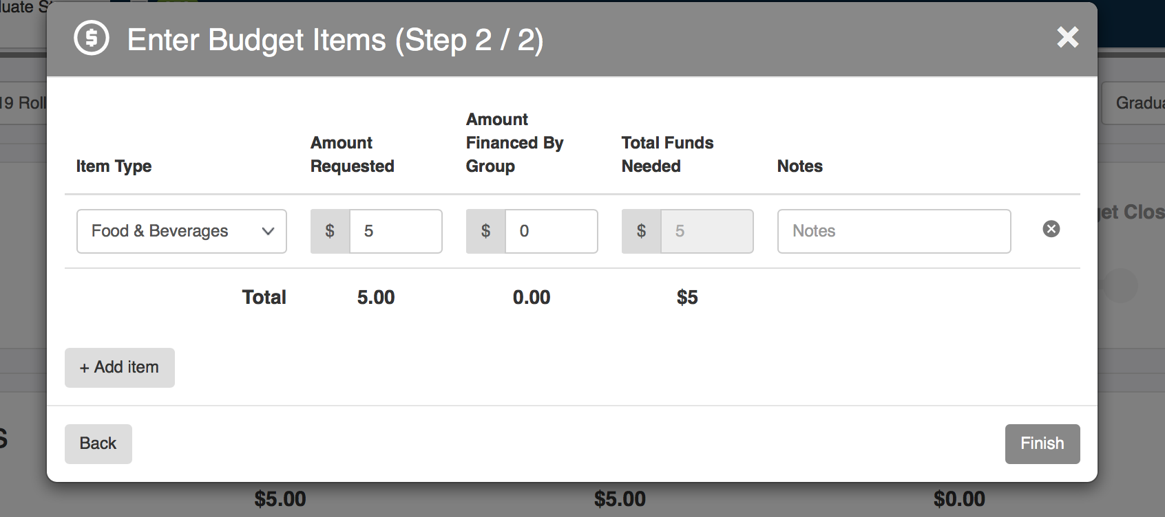

Slide 16
Notes:
Wait for Jenn’s reply

Slide 17
Other Fun Tidbits
Case Western Reserve University is a non-profit organization
Thus, there is no reimbursement for tax
So if you submit a receipt with tax, the tax will be subtracted from your total reimbursement
Tax Exempt Cards - http://cglink.me/f0b1ec2584c9ff0c09eff53a49f19c3f3bab4bb36daf943216a74c55da1e3c2
More on receipts
Must be itemized
Must show form of payment: i.e cash, visa, amex, etc

Slide 18
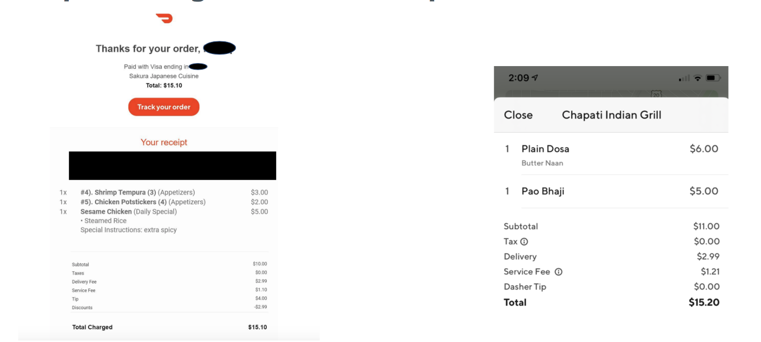
GOOD!
BAD!

Slide 19
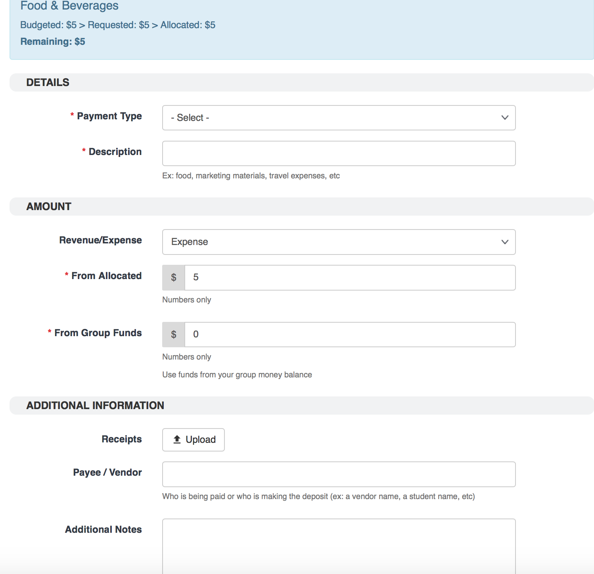
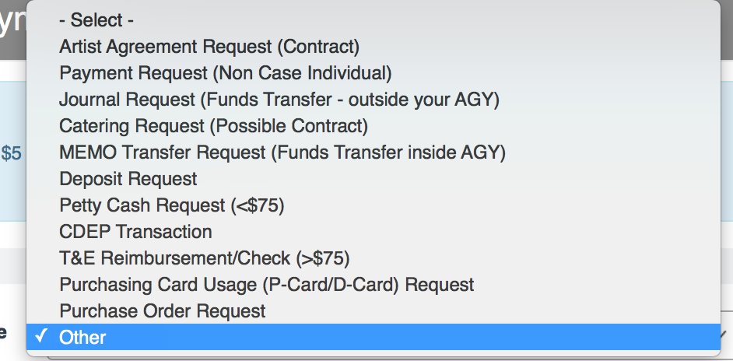
Notes
Payment Type:
Select T&E Reimbursement Check for any amount of reimbursement,
Checks will be mailed to address on SIS

Slide 20
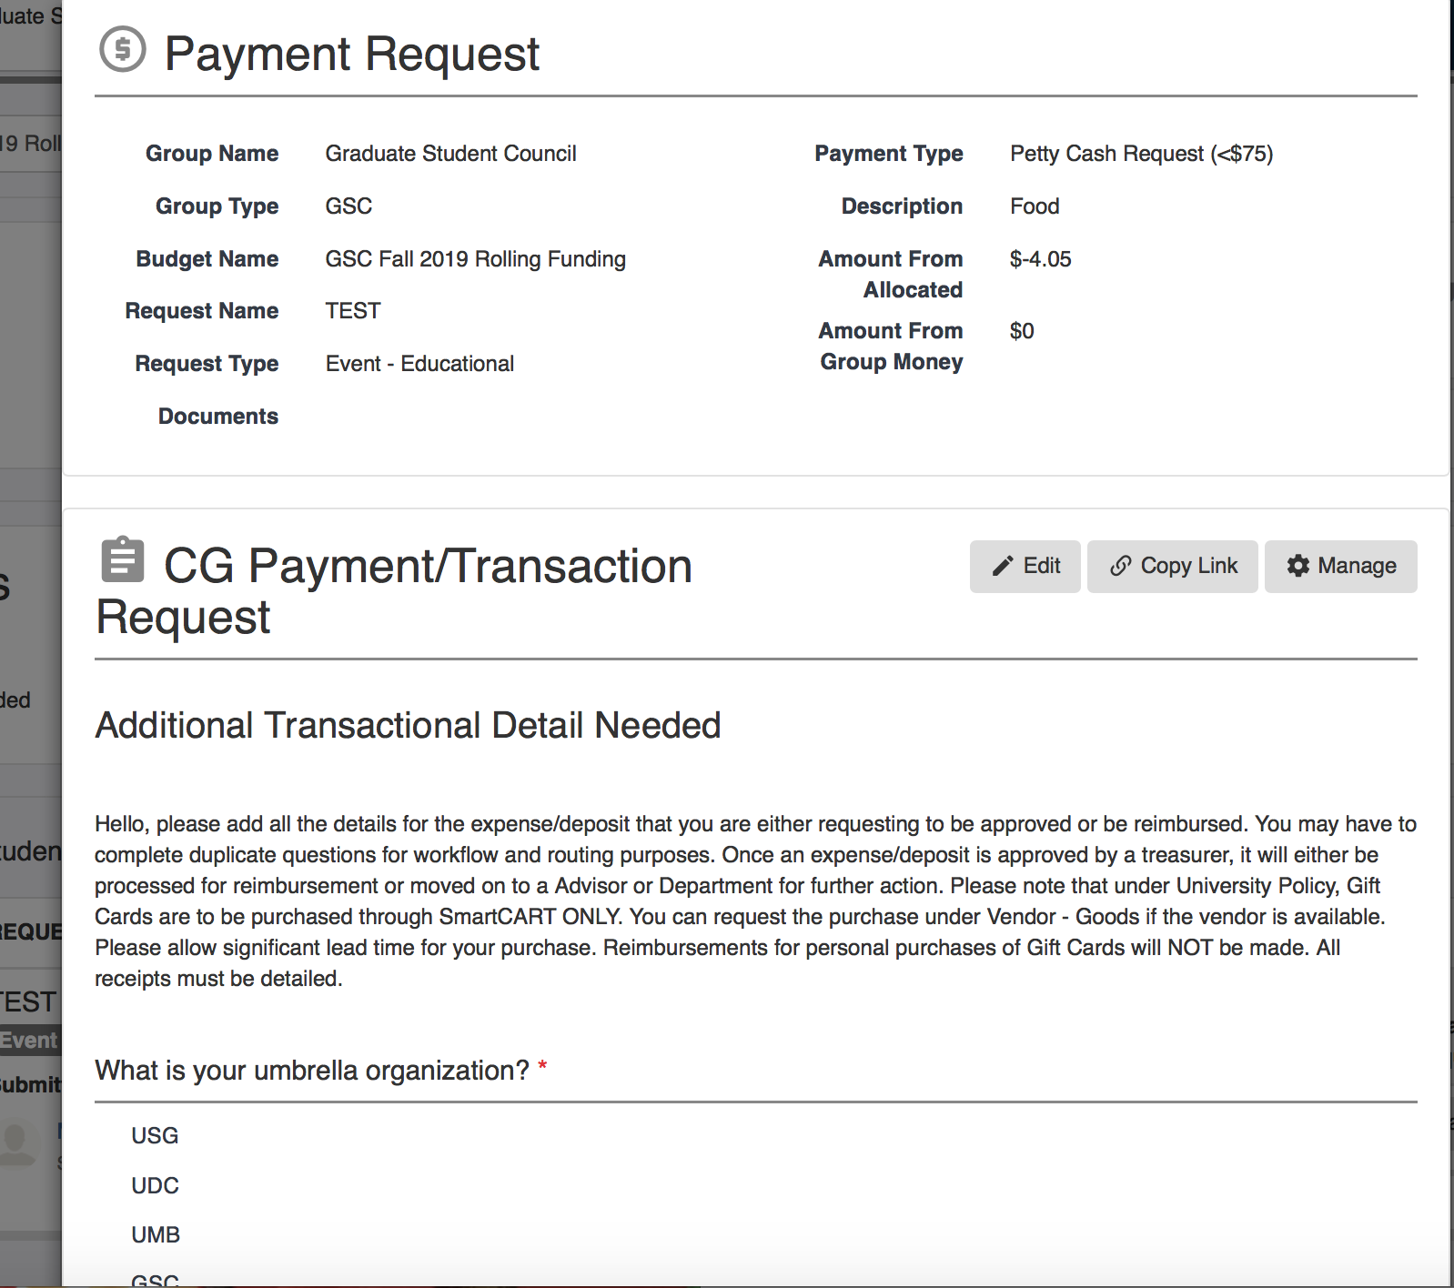

Slide 21
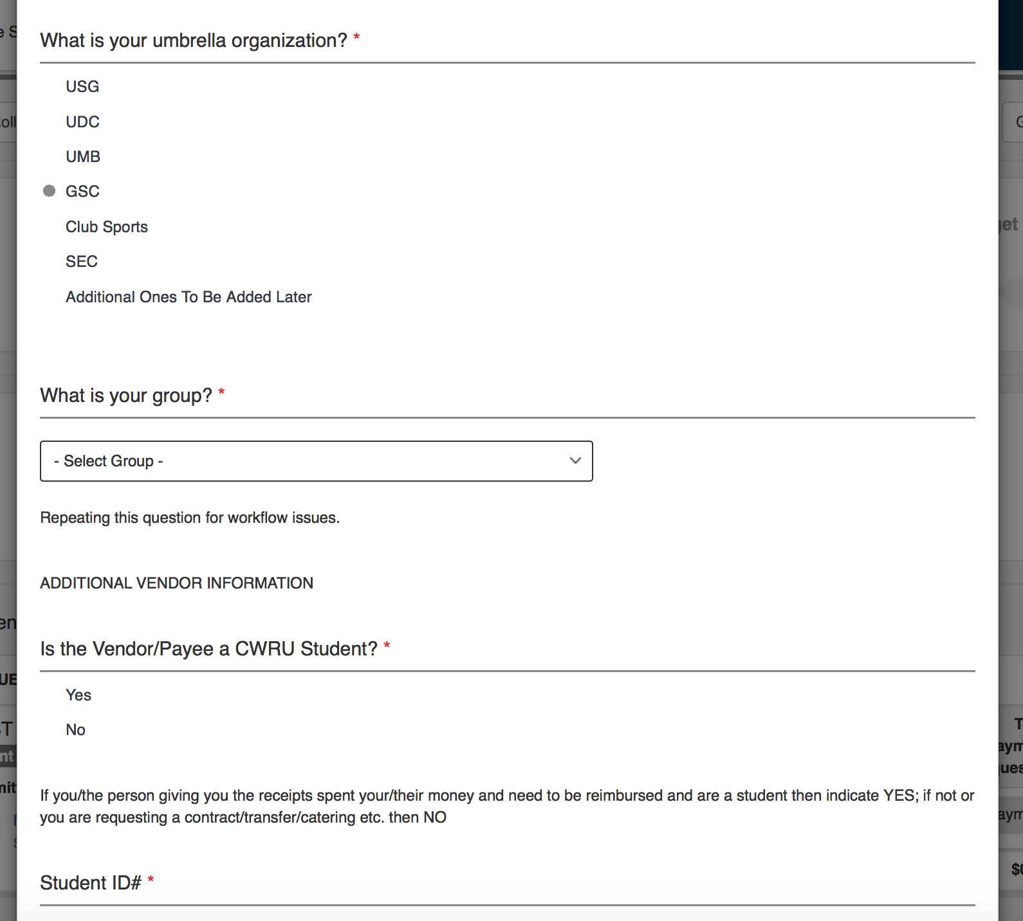
Notes:
Just because you do this does not mean you are guaranteed to get the money! If you are requesting for something that seems sus, I may ask for more information. I will not approve the money for you to, lets say, buy yourself a puppy. Not unless its really cute

Slide 22
But Meghan wait, I’m planning an awesome event and want more than $500, what do I do?

Slide 24
GSC Co-Sponsorships

Slide 25
What is a Co-sponsorship?
Ability for an organization to request money separate from $500/semester for an event
By doing this, the organization enters into an agreement with GSC that certain conditions will be met including
GSC logo on all promotional materials
Sharing promotional materials with GSC for us to use on our social media
**Funds not guaranteed

Slide 26
How do we apply?
Email me: mel163@case.edu
May be required to come into a GSC exec meeting and give a quick presentation
Application must be filled out one month prior to the event
If approved, you will have 2 weeks after the event to submit receipts

Slide 27
Interschool Co-Sponsorships

Slide 28
What is an Interschool Co-sponsorship?
Ability for an organization to partner with another organization outside their school which will allow them to request money up to $1000 for an event
This $1000 will take $250 from each org’s initial funds, but that other $500 will come from GSC
By doing this, the organizations do not have any requirements to promote GSC at the event
**Funds not guaranteed

Slide 29
Last minute things
Most important thing is to get things in by the deadlines
Patience is key when it comes to money, CampusGroups, and ME!
Again, if you don’t hear back from me send a follow up. I get busy just like you
Do not email me on a weekend and expect a reply before the week starts again
Same goes with breaks (Law School breaks may be different from your school’s)
Always feel free to reach out with questions!
At the end of the year, update your organization’s CampusGroups Page!!
New officers, etc.

